Slide 1
OPENSHIFT
Jim Garrett
Senior Solution Architect
jgarrett@redhat.com
July 2018

Slide 2
Agenda
Container Discussion
See how Red Hat OpenShift Container Platform makes it easy to build containers from source code
Deploy sample applications on Red Hat OpenShift Container Platform

Slide 3
Introductions
Name
Role/Title
Experience/knowledge with Containers?

Slide 4
Goal – Answer These Questions
Who are the characters?
What is the problem?
What is the Setting?
How do you solve the problem?
What happens at the end, what do you get out of it?

Slide 5



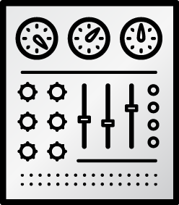

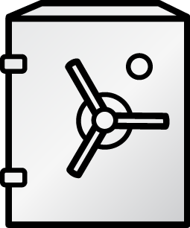







THE CHARACTERS
DEVELOPERS
I.T. OPERATIONS
Notes:
Developers have different motivations and concerns than the IT Operations.
Developer's job is to deliver a code
IT Operations’ job is to bring stability
Environment predictability
As a result, applications are designed and developed in accordance to Developers mindset and Operations requirements are layered over it at later stages of delivery, leading to frustrating frictions specially in the end of each delivery cycle.

Slide 6
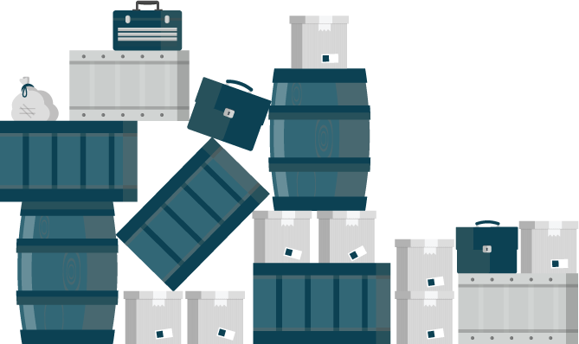
The Problem
Applications require complicated installation and integration every time they are deployed
Lots of Friction
Leads to poor quality of delivered service
Larger Deployments
Avoid pain by deploying less often
Notes:
Delivering an application into production is a non-trivial task
lots of friction and many back-and-forth cycles between Developers and IT Operations.
Painful deployments leads poor quality of the delivered service
Tendency to avoid the pain by deploying to production as seldom as possible.
Results in larger deployments with more features being delivered at once and higher risk of things going wrong, which results in more pain, fewer deployments, … and story goes on.

Slide 7
DEVOPS - Setting
Everything as code
Application monitoring
Automate everything
Rapid feedback
Continuous Integration/Delivery
Rebuild vs. Repair
Application is always “releaseable”
Delivery pipeline
Notes:
DevOps has Gained popularity in the last two years.
Many of the practices and values in DevOps aim at mitigating this problem described previously.
However implementing these practices proved to be extremely difficult using virtualization and other technologies which were available at the time.

Slide 8
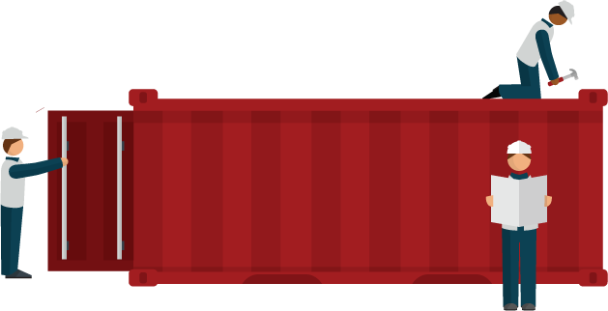
The Solution
Adopt a container strategy
Allows applications to be easily shared and deployed.
Simplifies the automation that DevOps provides
Provide consistent environment for Developers and Operations
Write once – deploy anywhere
Notes:
DevOps only took off when containers gained popularity
Simplifies the automation that DevOps provides.
Containers provide consistent environment and tools for both Developers and Operations
Simplify the deployment process regardless of what the application looks like
Recreate identical environments for development, testing, staging, and production
Write once; deploy anywhere

Slide 9

WHAT ARE CONTAINERS? It Depends Who You Ask
INFRASTRUCTURE
APPLICATIONS
Sandboxed application processes that run on a shared Linux OS kernel
SE Linux
Simpler, lighter, and denser than virtual machines
Portable across different environments
Package the application and all of its dependencies
Deploy to any environment in seconds and enable CI/CD
Easily access and share containerized components
Notes:
Infrastructure perspective
containers rely on Linux operating system features
isolate slices of the underlying operating system.
Has some libraries from Linux operating system inside it.
Consume less resources compared to virtual machines.
Pose complexities that need orchestration and management to be used effectively.
Application perspective
way to package an enterprise application in a self-contained artifact.
Simple to share those apps across the organization.
Developers have full control over the content of a container

Slide 10
THE SOLUTION
Container
App
Controlled by Developers
Operating System
Controlled by IT Operations
Virtual Machine
Hardware
Notes:
IT Operations controls
hardware, virtualization layer, operating system and make sure they are patched, secure and managed in accordance to their best practises.
know how to run containers effectively on top of that infrastructure to maximise utilisation.
Developers
control the application, frameworks and libraries used in the application and package that as a container which is delivered to IT Operations.
mitigates the traditional friction between the two teams in the software delivery process.

Slide 11


THE SOLUTION
DEVELOPERS
I.T. OPERATIONS
Notes:
The promise of containers is that everybody’s needs are fulfilled
teams can work together in better ways than previously they were able to.
In the eyes of many inside the organization, containers come to the rescue as the common language between Developers and IT Operations.
Containers can drive a revolutionary change into how these two sides of an IT organization work together;
allow developers and the line of business to own their applications in the form of containers that then can be deployed, maintained, and operated on top of infrastructure that the Ops team provides, without compromising security or compliance.

Slide 12
WE NEED MORE THAN JUST CONTAINERS
WE NEED ORCHESTRATION!!!
Scheduling Decide where to deploy containers
Security Control who can do what
Lifecycle and health Keep containers running despite failures
Scaling
Scale containers up and down
Discovery Find other containers on the network
Persistence
Survive data beyond container lifecycle
Monitoring Visibility into running containers
Aggregation
Compose apps from multiple containers
Notes:
Although building and running single containers on a host is fairly simple, build and running multi-container application across multiple infrastructure requires more than just containers.

Slide 13
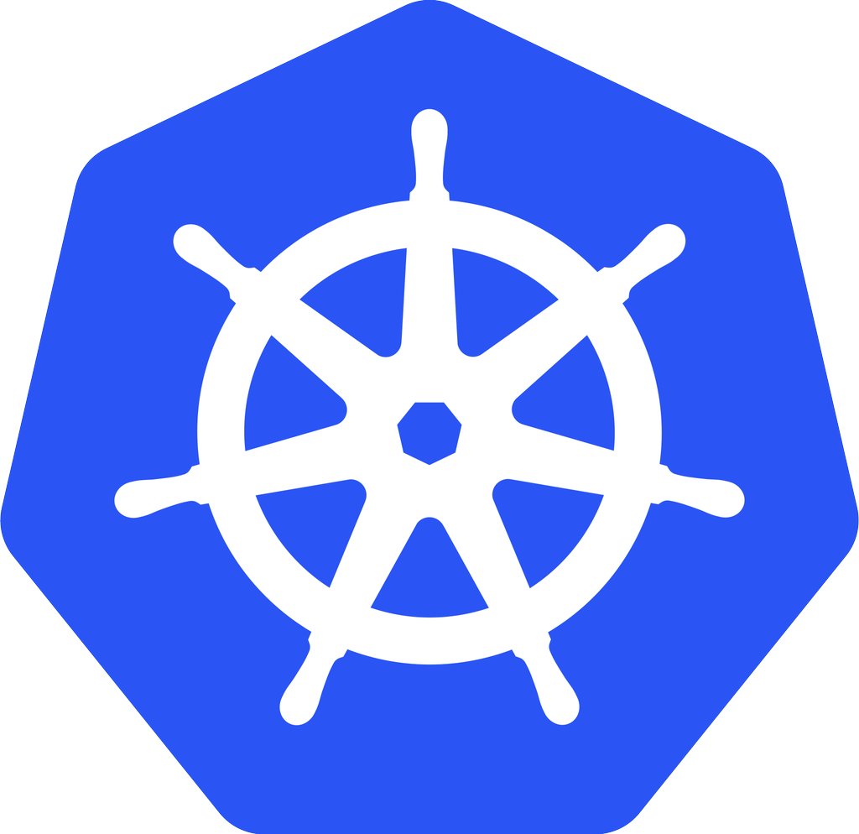
Kubernetes - open-source ORCHESTRATION framework
Developed by Google
Manages container lifecycle, health, scaling
Has its own Command Line Interface and API
Red Hat is THE top contributor to Kubernetes, after Google
kubernetes
Notes:
Kubernetes automates deployments of containers across the hosts
Kubernetes
open-source orchestration framework
developed by Google
manage the containers lifecycle, health, scaling, authentication, discovery and persistence.
15+ years of experience
Red Hat along with Google is the top contributor to the Kubernetes project.

Slide 14
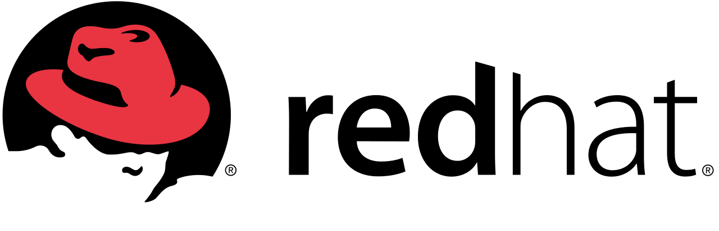

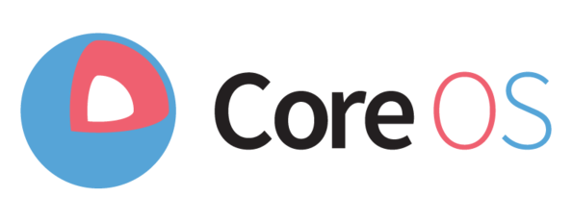

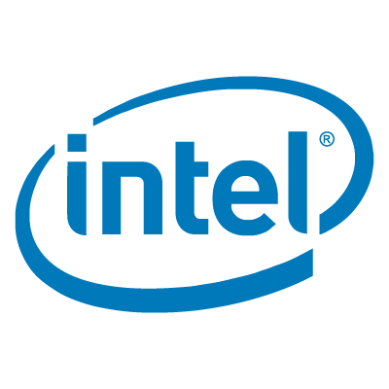











INDUSTRY CONVERGING ON KUBERNETES
Notes:
Community and vendor interest in Kubernetes is huge in the container market and many vendors have adopted Kubernetes within their platforms, sometimes at cost of replacing their own proprietary orchestration, as the standard container orchestration framework.
Platforms
Google: Container Engine
Red Hat: OpenShift
Engine Yard: Deis
Intel: OpenStack on Kubernetes
Apprenda: Apprenda
Apcera: Apcera
VMware: Photon Platform
Walmart: OneOps
Canonical: Kubernetes
CoreOS: Tectonic
Rancher: Rancher
Mesosphere: Enterprise DC/OS
Huawei: Cloud Container Engine
Microsoft: Azure Container Service

Slide 15
BUT WAIT, THERE’S MORE!
Multi-tenancy
Teams and Collaboration
Routing & Load Balancing
Quota Management
CI/CD Pipelines
Image Build Automation
Role-based Authorization
Container Isolation
Capacity Management
Vulnerability Scanning
Infrastructure Visibility
Chargeback
Notes:
Even that still is not enough. There are more capabilities needed to successfully taking these containers to production.

Slide 16

Docker
Kubernetes
Building, Distributing and Running containers at scale
Leading enterprise distribution of Kubernetes
Rapid Application
Deployment
Scaling
Notes:
OpenShift is Red Hat’s container platform based on docker and Kubernetes that brings in all the pieces together
leading enterprise distribution of Kubernetes
optimized for continuous application development and multi-tenant deployment.
adds developer and operational centric tools to enable rapid application development
Provides easy deployment and scaling
Red Hat is a leading contributor to the docker and Kubernetes projects.

Slide 17
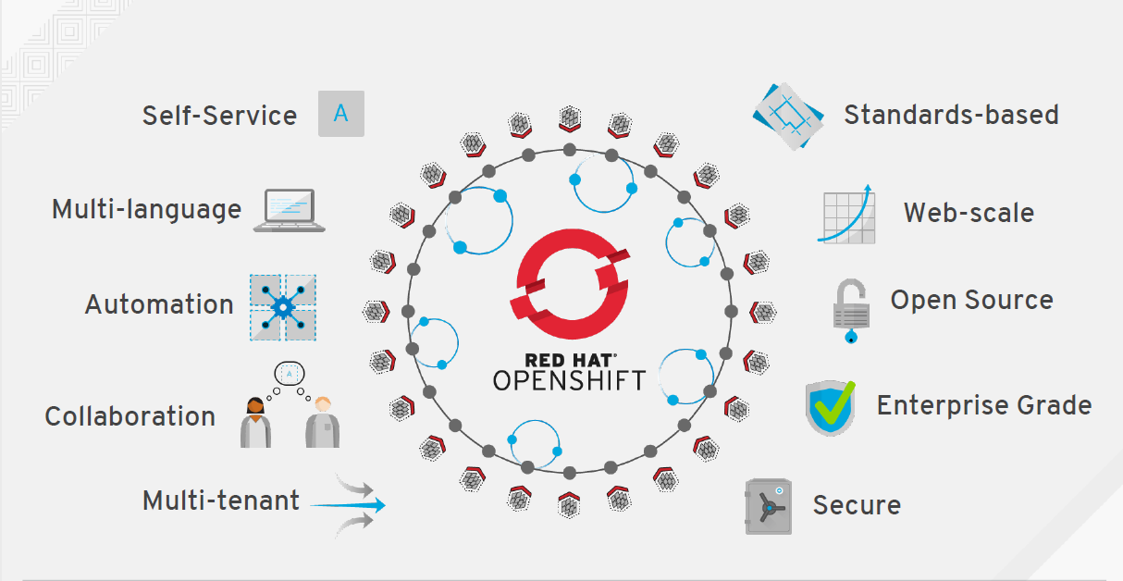

Slide 18

ARCHITECTURE

Slide 19
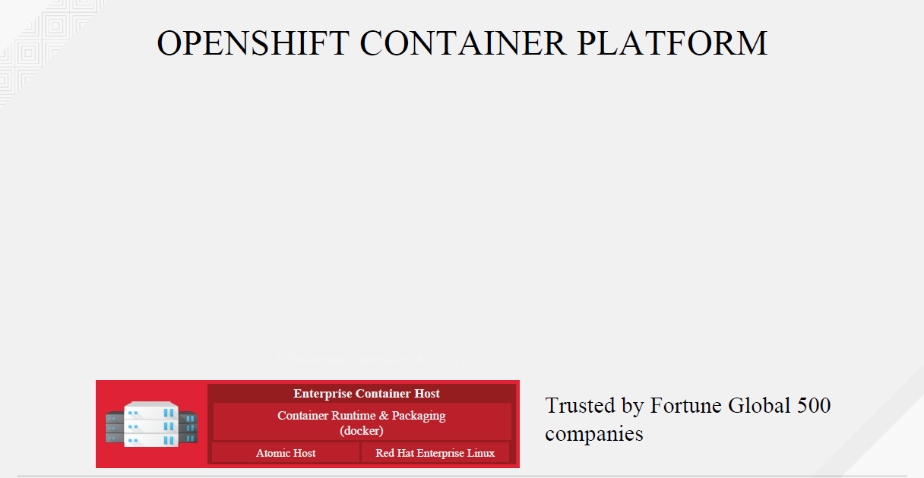

Slide 20
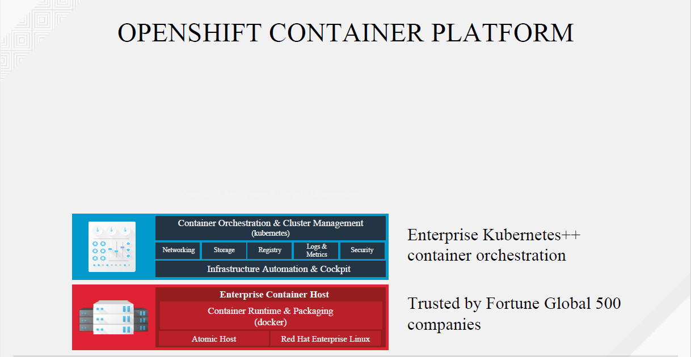

Slide 21
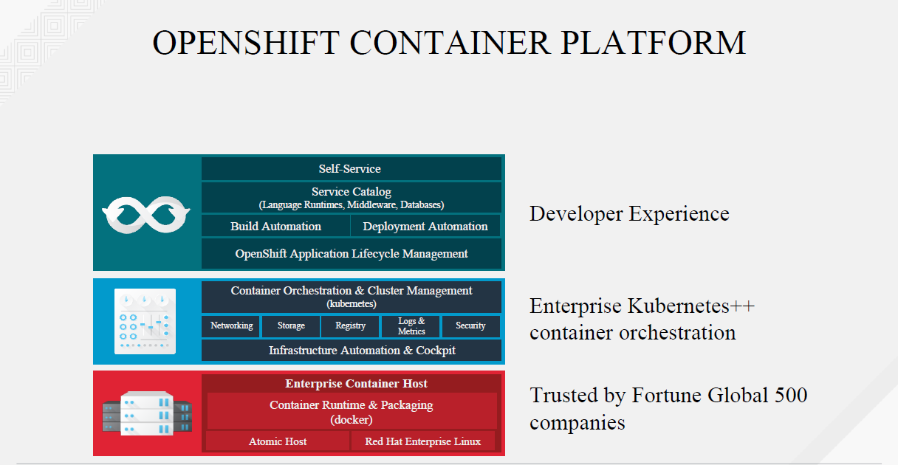

Slide 22
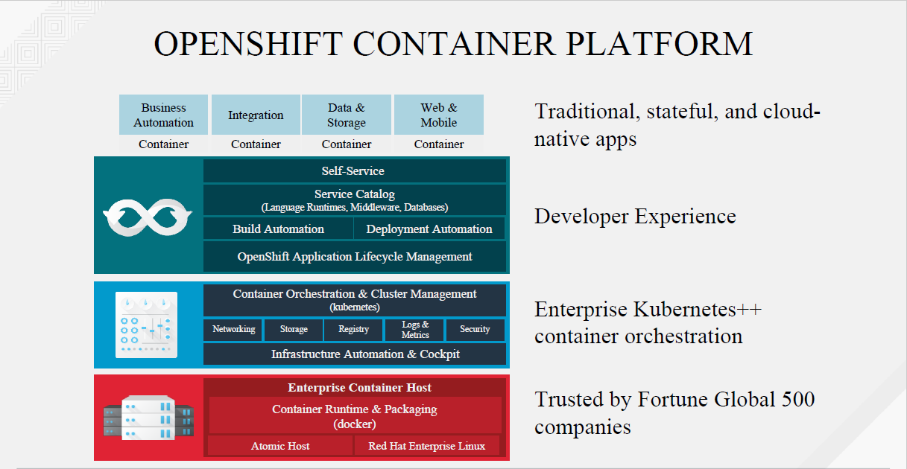

Slide 23
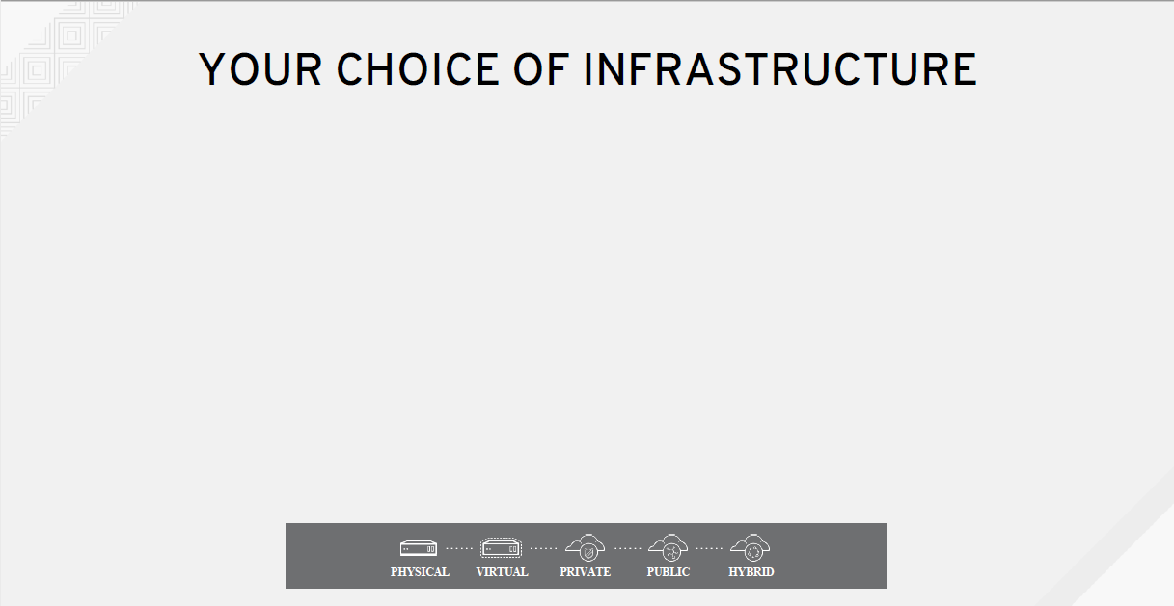

Slide 24
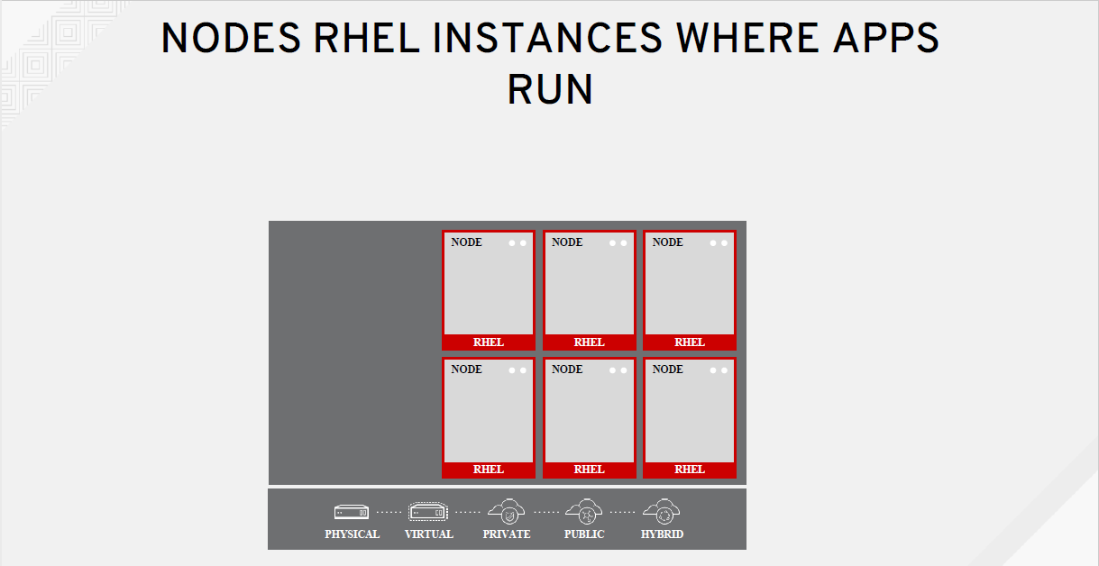

Slide 25
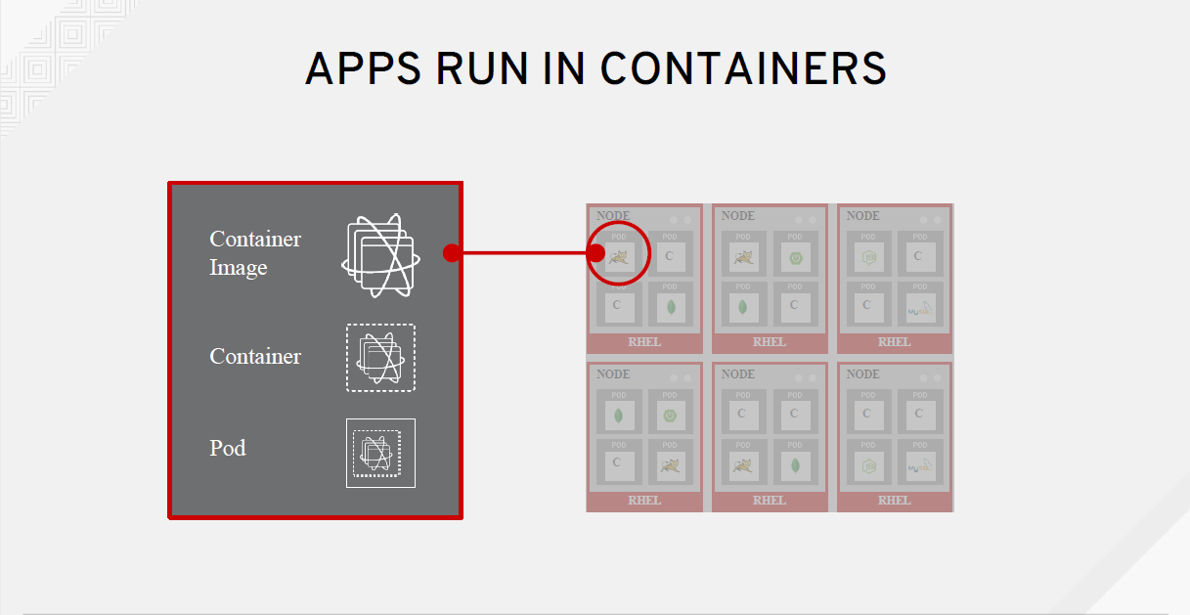

Slide 26
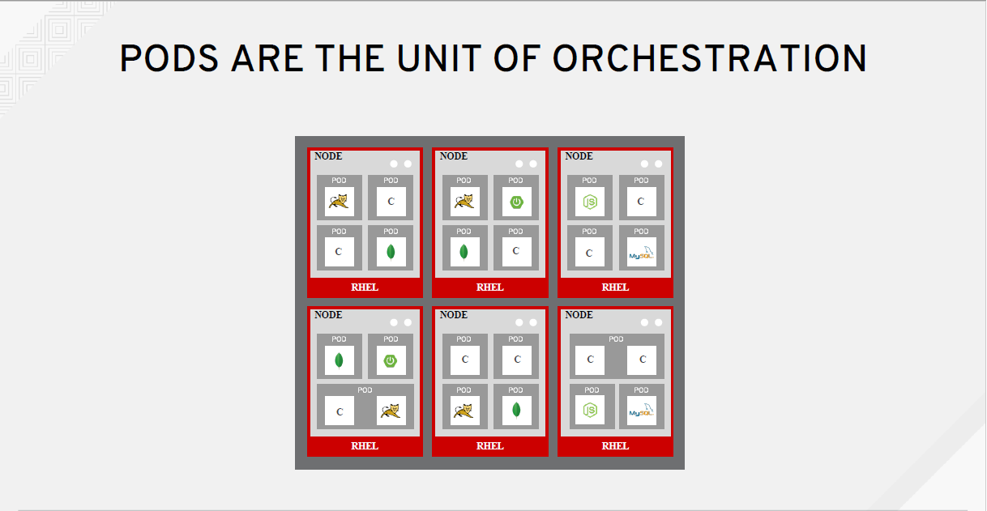

Slide 27
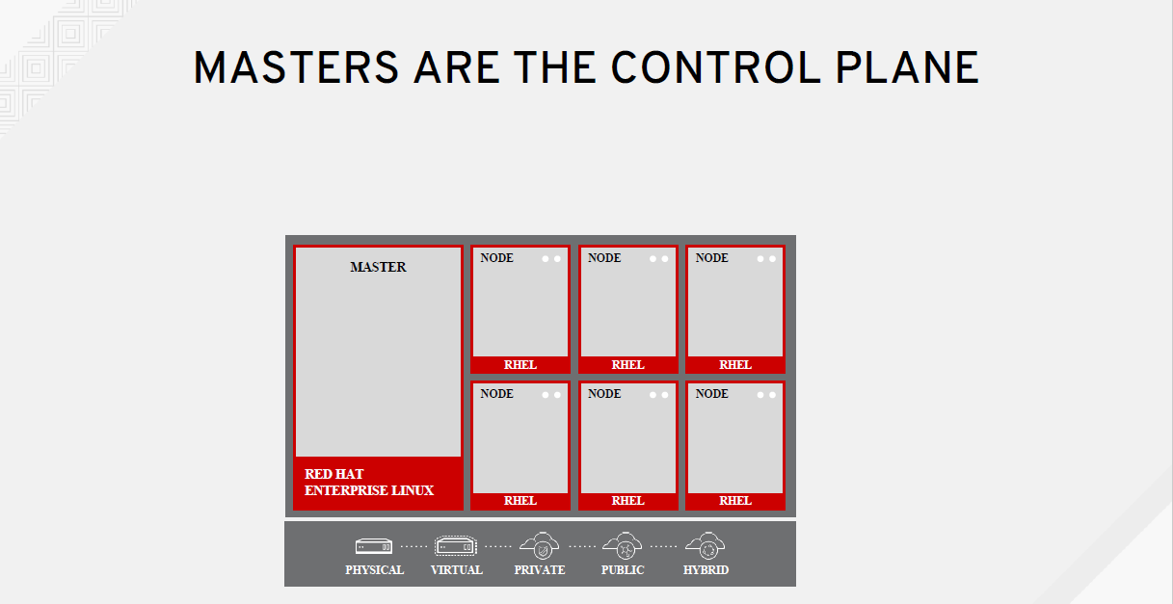

Slide 28
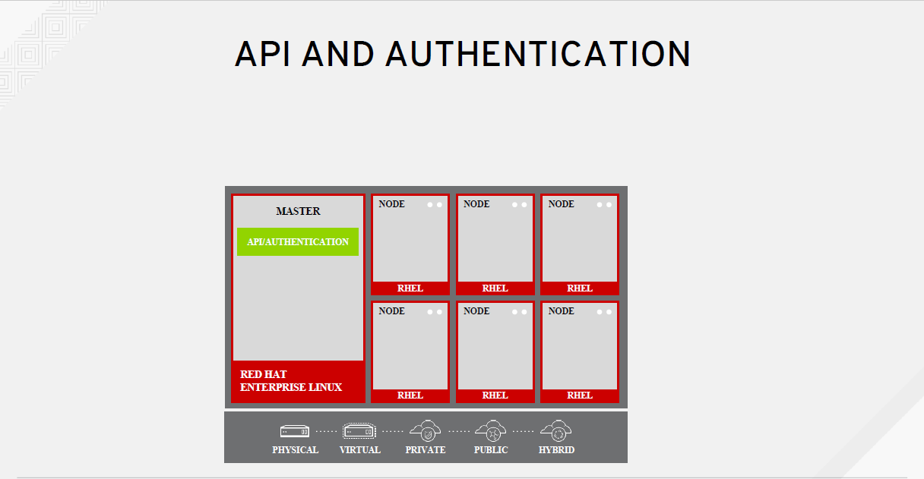

Slide 29
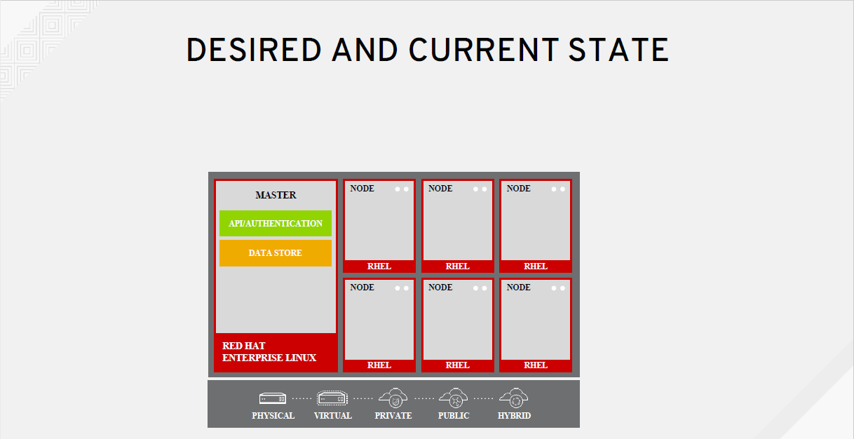

Slide 30
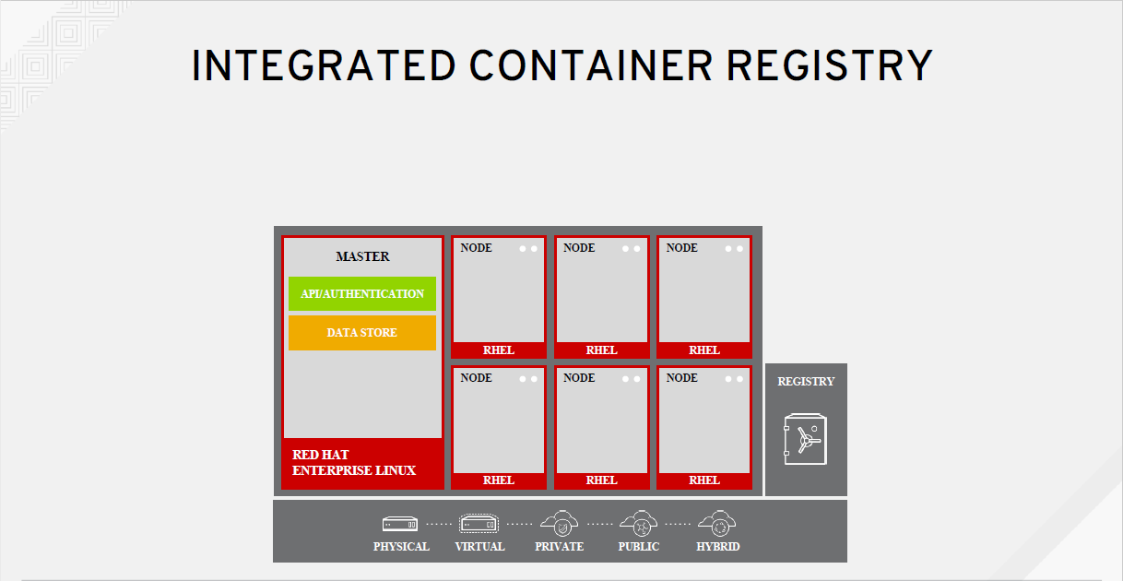

Slide 31
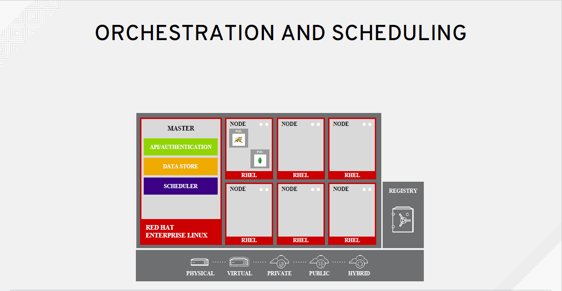

Slide 32
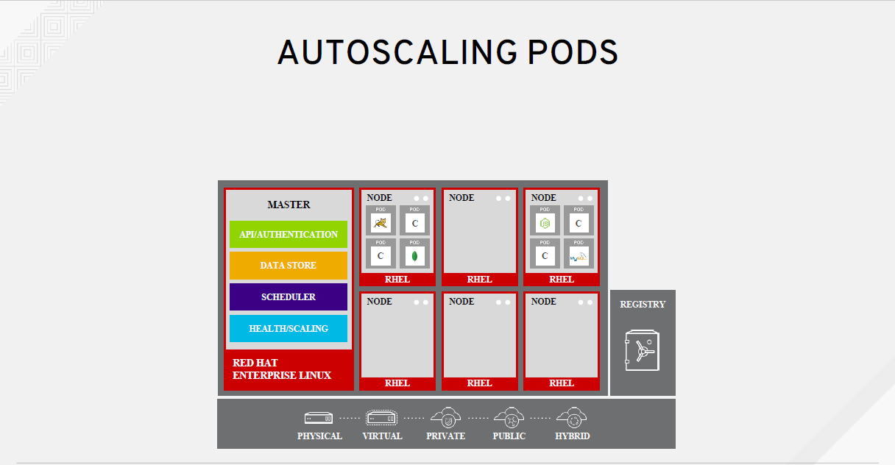

Slide 33
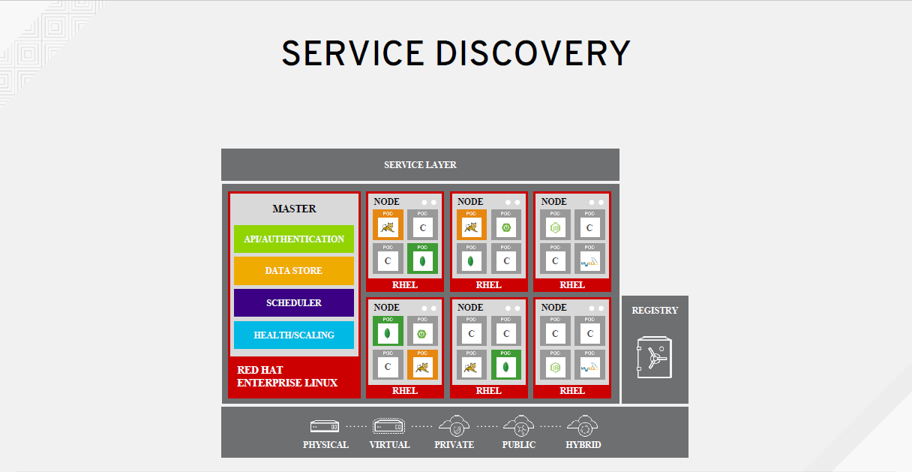

Slide 34
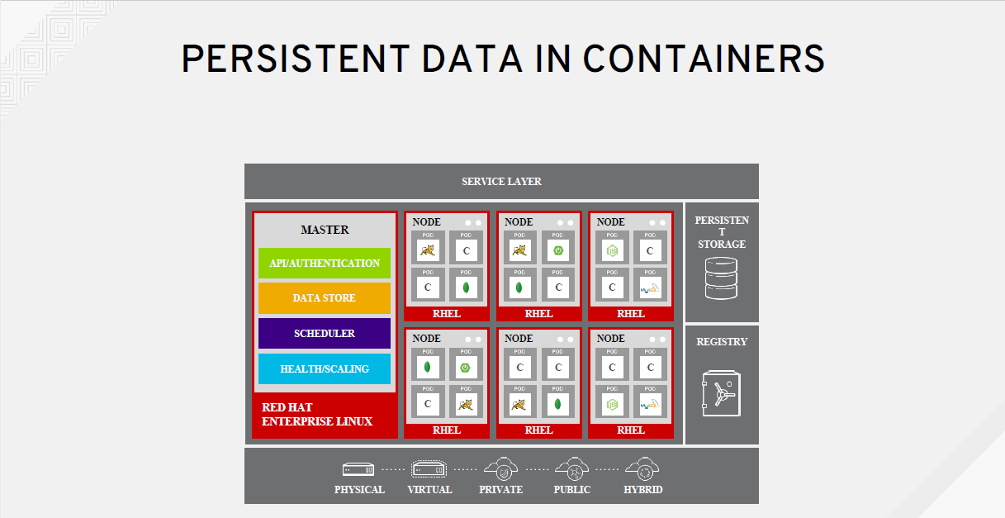

Slide 35
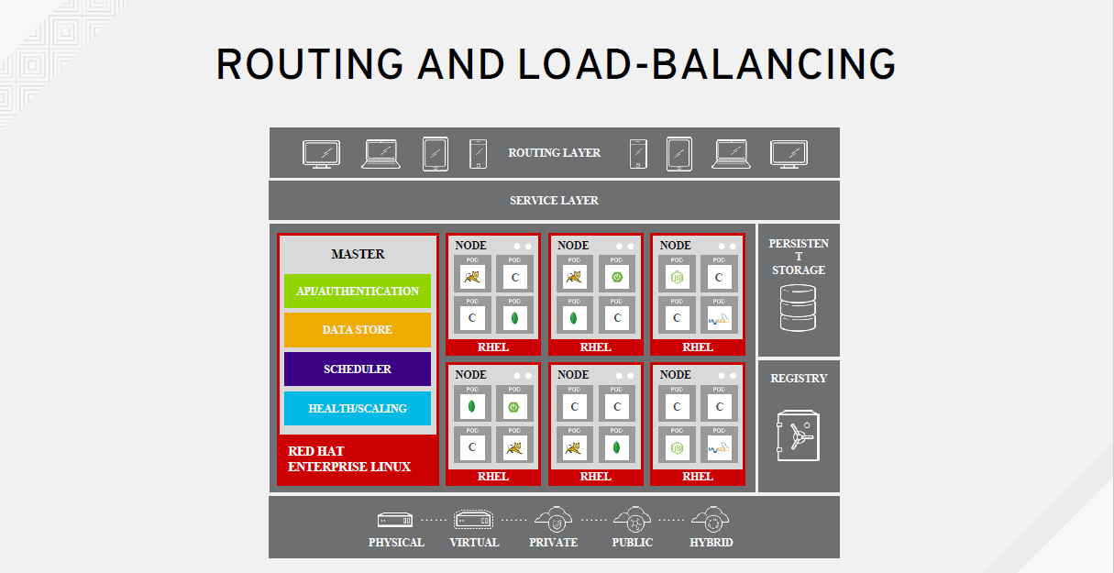

Slide 36


Slide 37
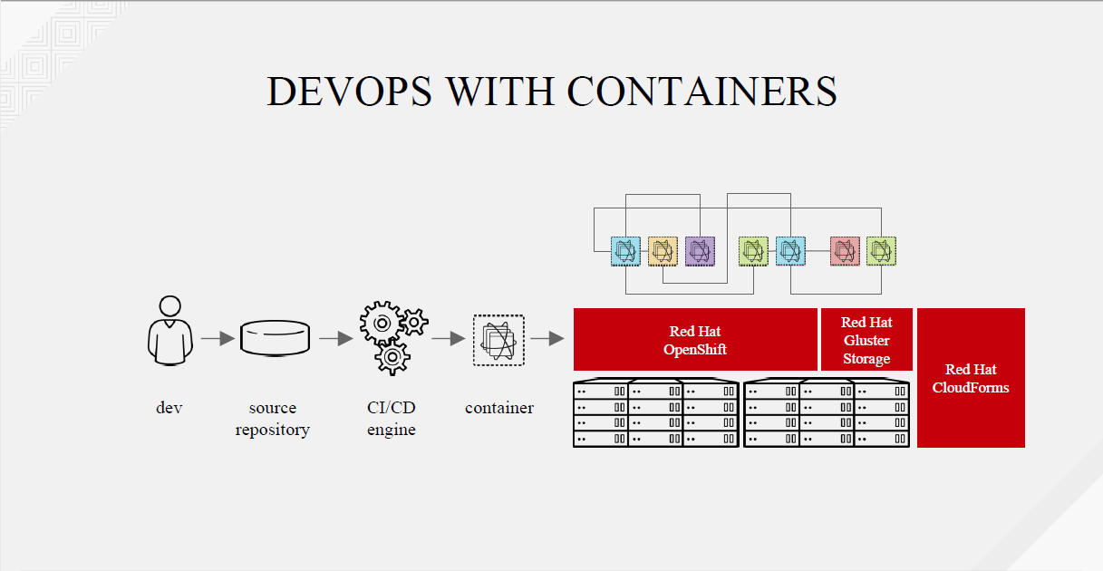

Slide 38
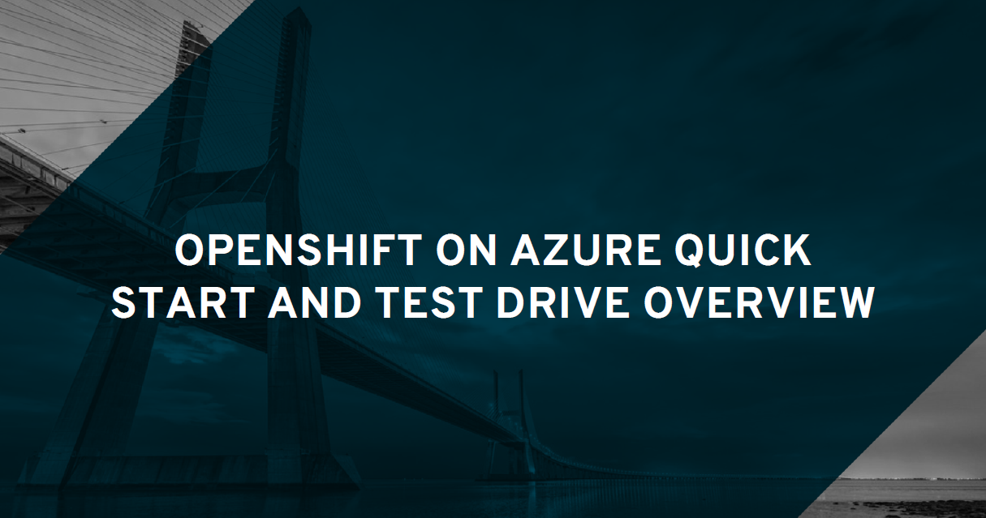

Slide 39
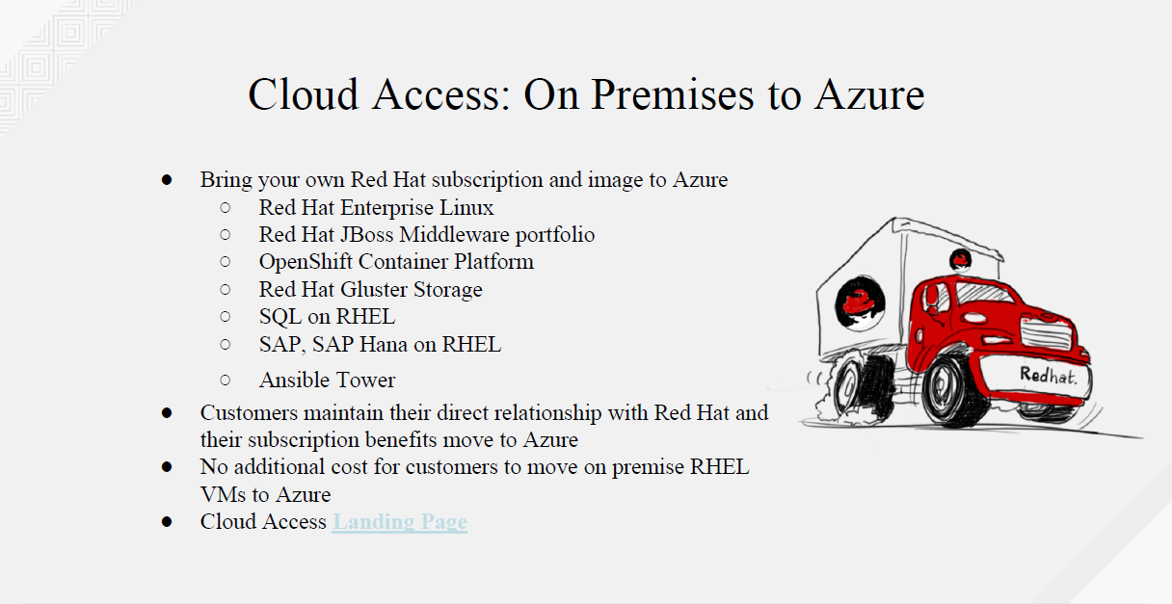

Slide 40
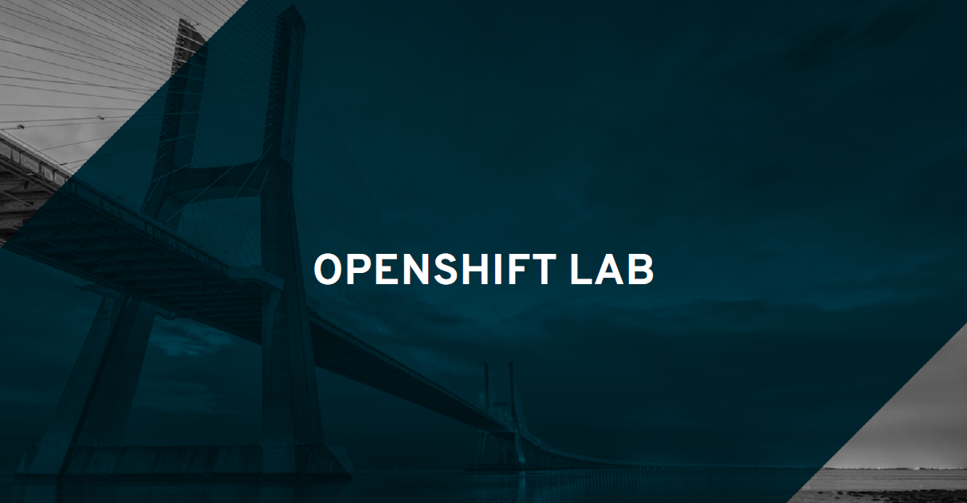

Slide 41
Lab Material
https://tinyurl.com/y9ee8ctd
OpenShift Console Login
https://master.capgemini.openshiftworkshop.com
OC Login
oc login https://master.capgemini.openshiftworkshop.com –u <user#>
Password: r3dh4t1!

Slide 42
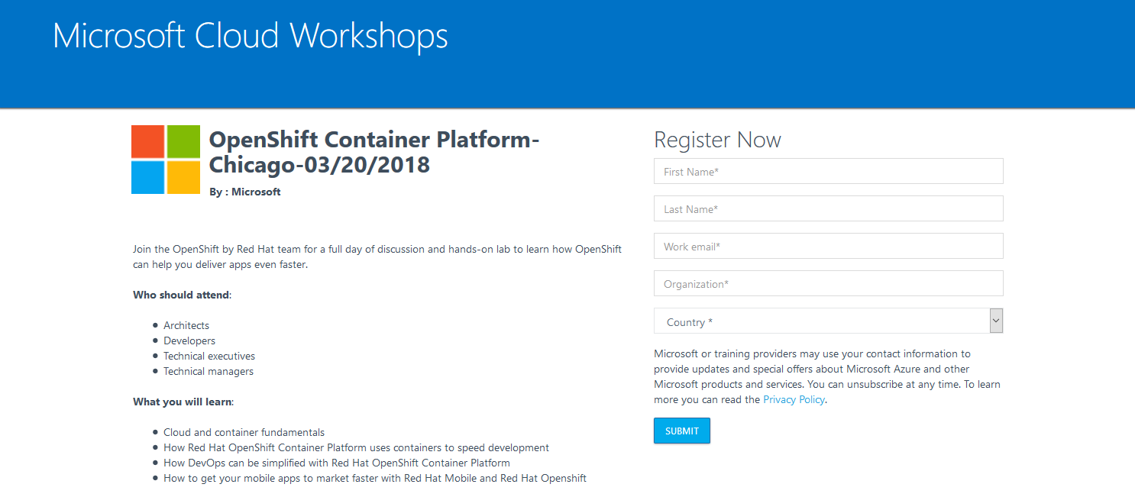
http://bit.ly/ocp-chicago

Slide 43
THANK YOU
plus.google.com/+RedHat
facebook.com/redhatinc
linkedin.com/company/red-hat
twitter.com/RedHatNews
youtube.com/user/RedHatVideos

Slide 44
SECURING CONTAINERS: 10 LAYERS OF SECURITY
Container Host & Multi-tenancy
Container Content
Container Registries
Building Containers
Deploying Containers
Container Platform
Network Isolation
Storage
API Management
Federated Clusters
10 Layers of Container Security Presentation

Slide 45
No Avoiding Diverse Workload Requests
Cloud Native
Ordinal Services
Low Latency
Off Platform Services
Replication Control
PV assignment
Autoscale
DaemonSet
podSpec
Templates
Spring/JDK
Circuit Breaker
Java Platform Classes
classic clusters
storage to instance pairing
local storage
IP/Hostname tolerance
Leader Election
HA Pods
NUMA
Device Passthrough
sysctl support
network separation
sequenced startups
SELinux Control
non-VXLAN
multi-home pods
kernel modules
hugepages
Service Broker
Metering
Variable Propagation
Service Linking
Service Discovery
Service Permission
Notes:
The features of the platform are driving our customers to place us against competitors that we traditionally would not have had to beat in order to win their business. At the same time, even the simplest of applications now have extensions that service them that are more complex.

Slide 46
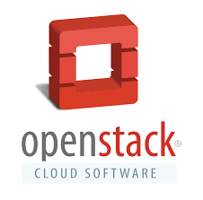

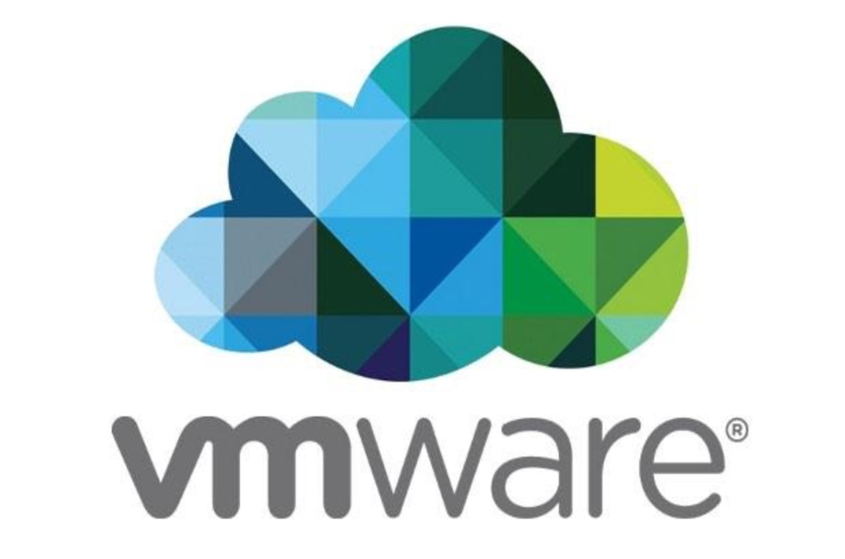
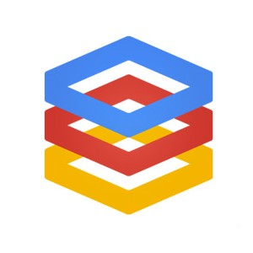
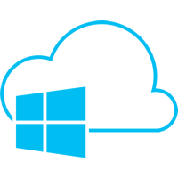
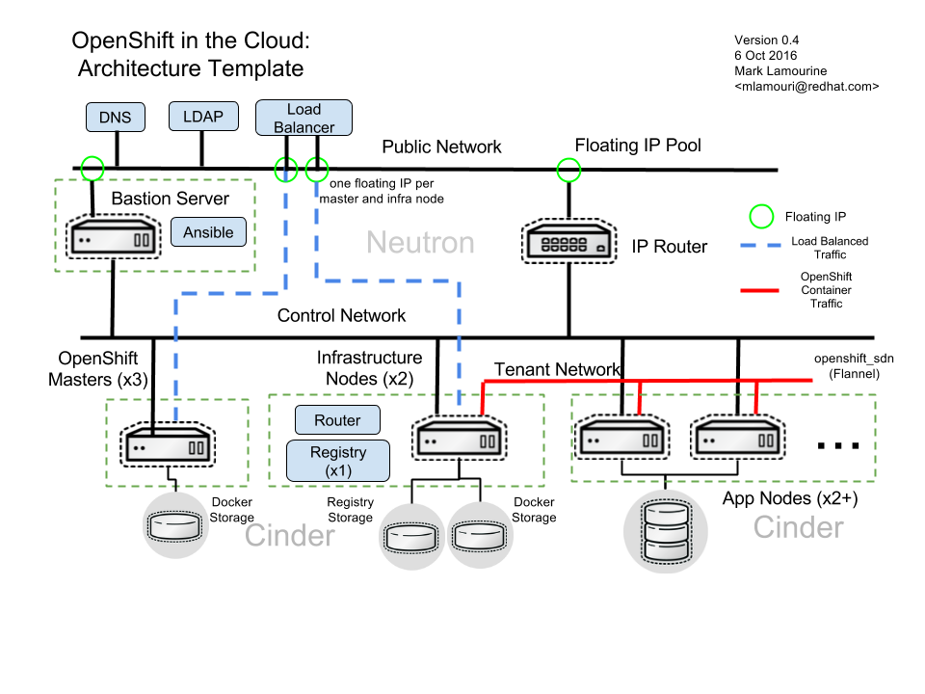
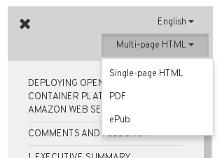
E2E Provider Integration
Reference Architecture
Implementation Guides
 | OpenShift Container Platform (ocp-supplemental = 2-4 wks after GA)
 | 3.5-ocps | 3.6-ocps | 3.7-ocps | 3.8-ocps
AWS | 3.5 | 3.6 | - | 3.8
GCE | 3.5 | 3.6 | - | 3.8
VMware | 3.5 | 3.6 | - | 3.8
Azure | 3.5¹ | 3.6 | - | 3.8
OSP | 3.4 (3.5¹) on 10 | Upgrade Scenarios | 3.6 on 11 | 3.7 on 11
NEW
Available in multiple formats
¹Currently in review

Slide 47
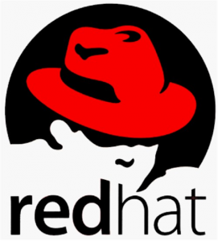
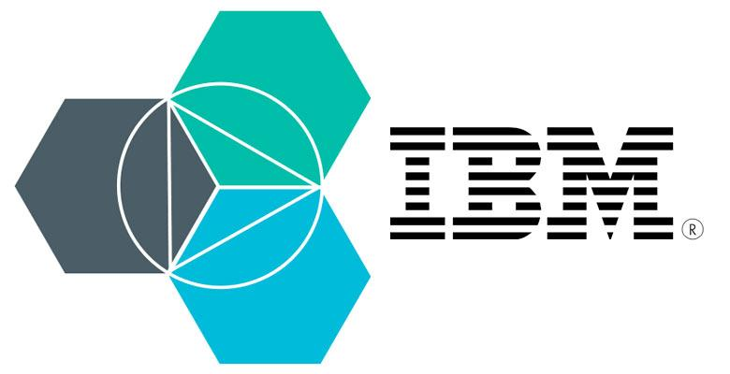
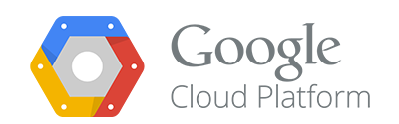


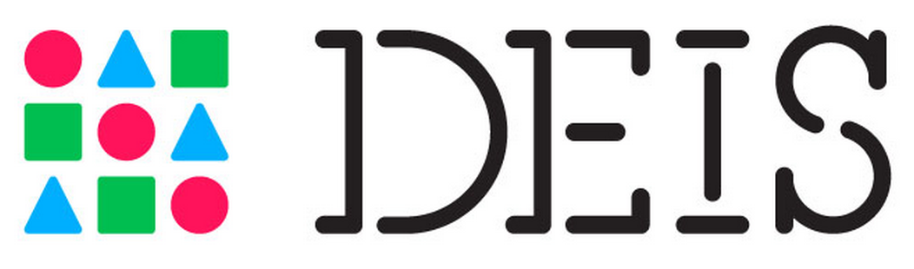
Service Broker
General Service Broker API
Service Parameterization
Generalization and Removal of Cloud Foundry Requirements
Binding Semantics
AUTH
Foundation for Service Catalog + Marketplace
github.com/servicebroker/servicebroker

Slide 48

Using Ansible to Orchestrate OpenShift Services
Overview
Define, extend, and deliver “simple” to “complex” multi-container OpenShift services
Standardized approach to using Ansible to manage and provision applications
Leverage existing investment in Ansible roles/playbooks
Easy management of applications for “simple” cloud-native apps
Ansible Service Broker
Ansible Playbook Bundle
Embraces Service Catalog and Open Service Broker API concepts
Supports:
Traditional S2I deployments
Provisioning of pre-existing images
Orchestrating off-platform (public cloud) services
Deploying multi-service solutions
Lightweight application definition (meta-container)
Simple directory employing:
Named playbooks [provision, bind, …] to perform Open Service Broker actions
Metadata containing a list of required / optional parameters during deployment
Embedded Ansible runtime

Slide 49
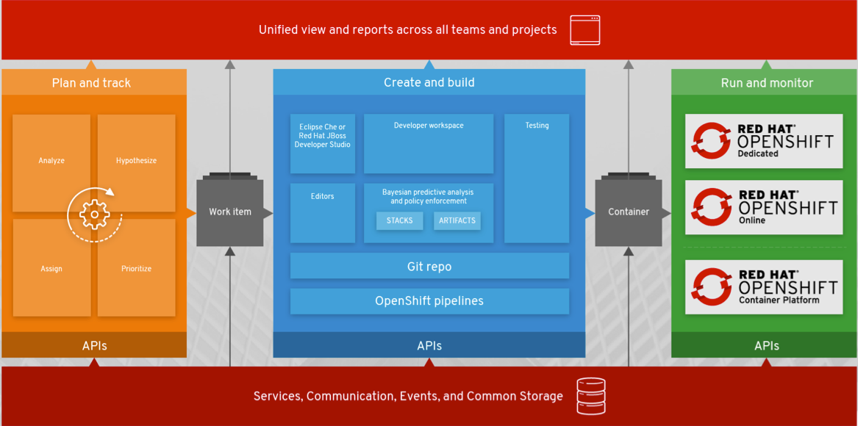
Developer Tools-aaS : OpenShift.io

Slide 50
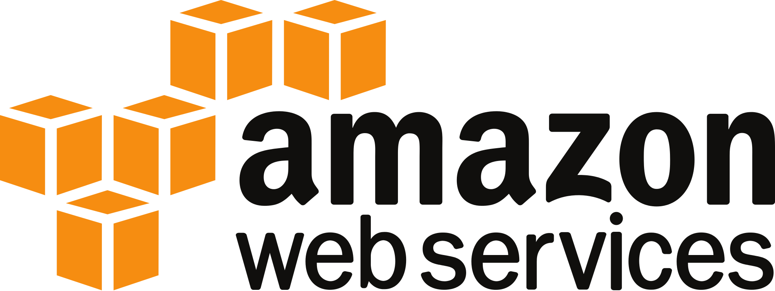
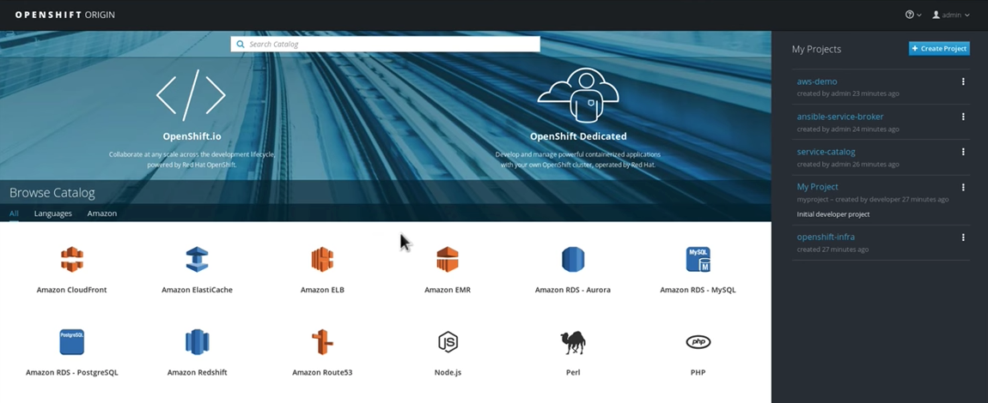
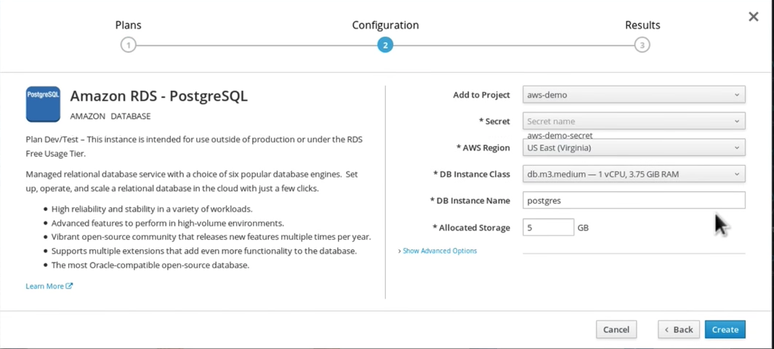
Amazon AWS Services in OpenShift
Native integration of AWS services in OpenShift via Open Service Broker API
Eliminates complexity of provisioning, security model and resource consumption of AWS services
Users will be able to bind their containerized apps running in OpenShift, to services running on AWS, directly from the OpenShift Console
OpenShift configures all project dependencies, runtime configurations and automates deployments
Joint support path for applications using OpenShift integration with AWS; GA projected for Q4 CY17
More details: Press release, Andy Jassy’s video, blog, demo video

Slide 51
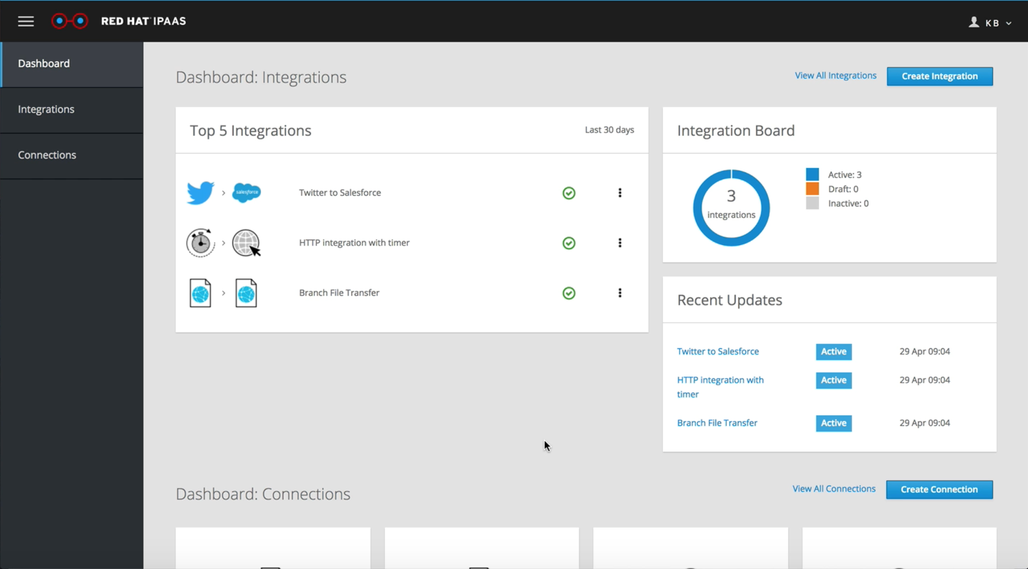
Integration Platform-as-a-Service (iPaas)
Integration platform for low-code environments and non-technical users
Create, connect and manage integrations between commons systems and data sources quickly (no installation needed)
Create and connect APIs using web based tooling (3scale API Management)
Point and click tools to build, test & deploy integrations
Based on Syndesis.io, JBOSS Fuse, Apache Camel and OpenShift
Currently in public preview
More details: Blog, demo video

Slide 52
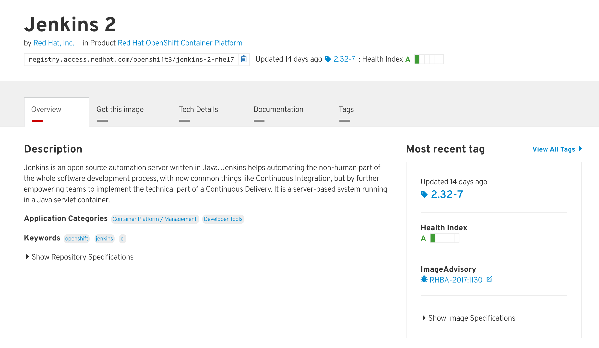
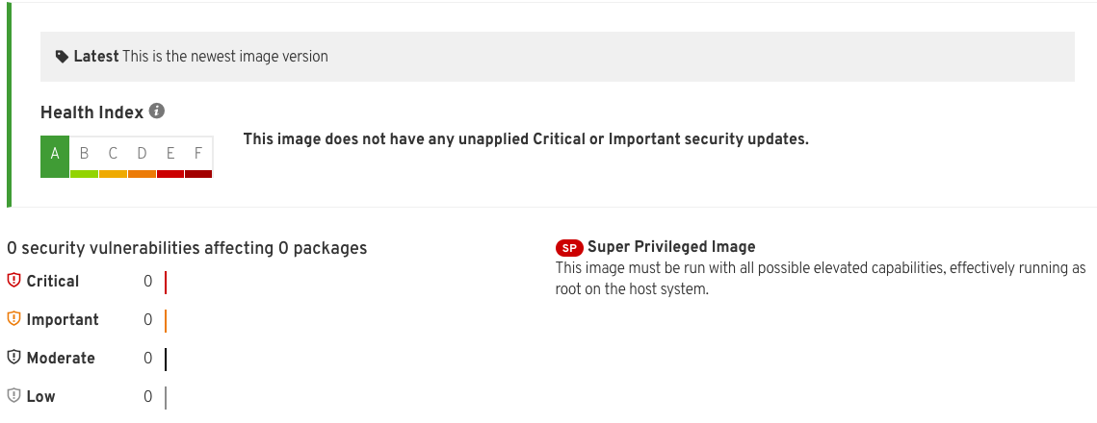
Container Catalog & Health Index
Container quality and security rating
Based on age and impact of unapplied security errata
Includes A to F grade and image advisories
Integrated into Red Hat Container Catalog at access.redhat.com/containers
Link to Press Release
Notes:
not limited to security errata (RHSA) since it also includes RHBA and RHEA a CVE is attached to it
RHCC leverages both image and content (RPM) advisories. image advisories shown on screenshot, content advisories on security details page (pet container use case) in addition to the actionable result (fixed in image) which is a unique feature of RHCC not in openSCAP or any other scanner yet

Slide 53
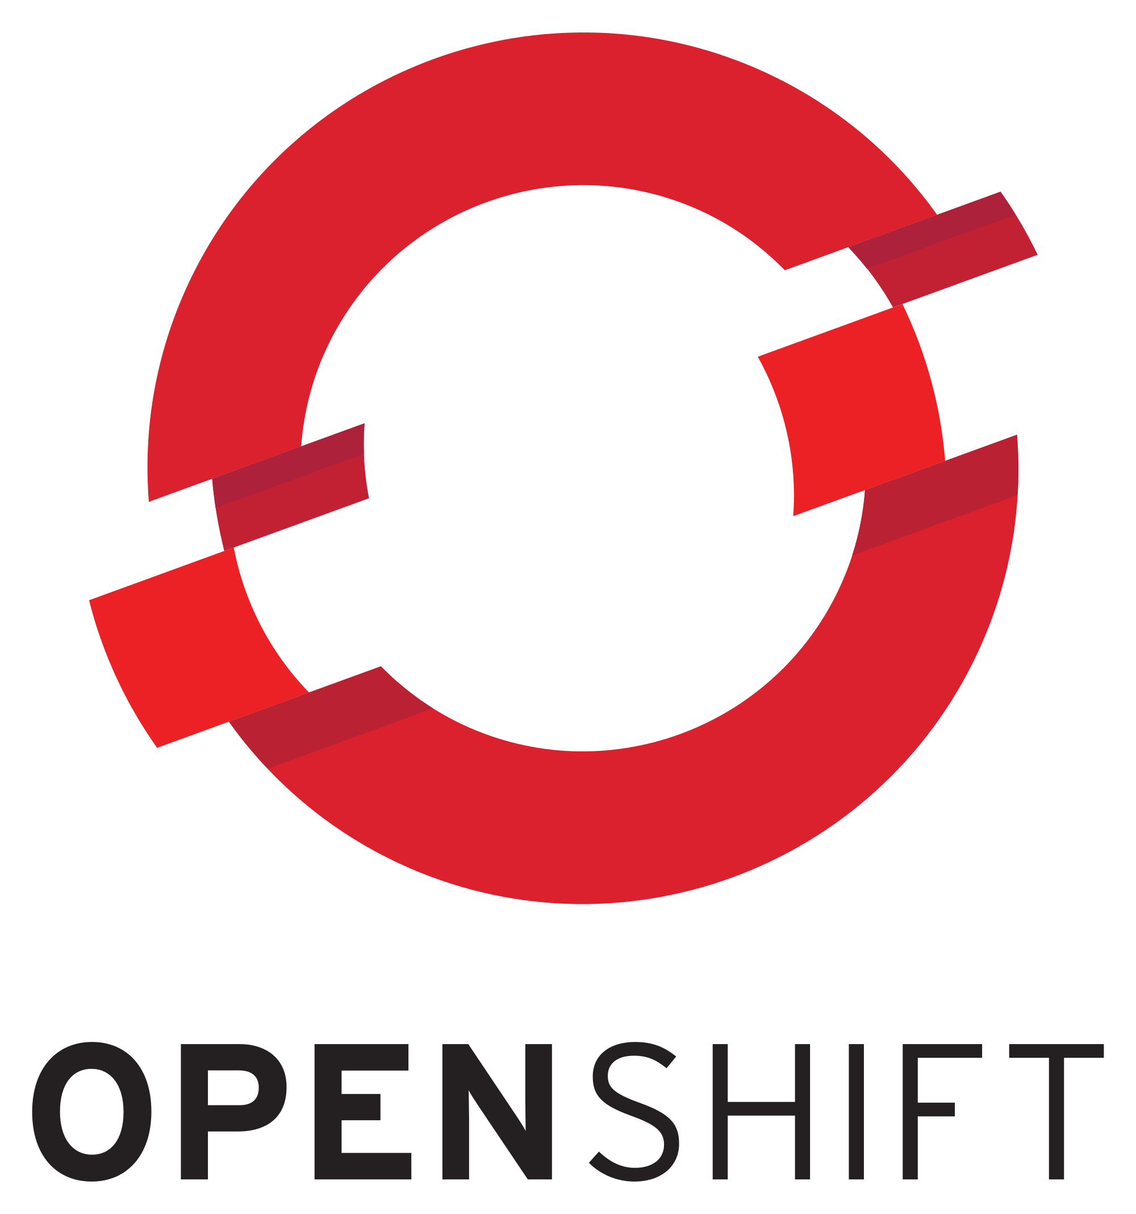

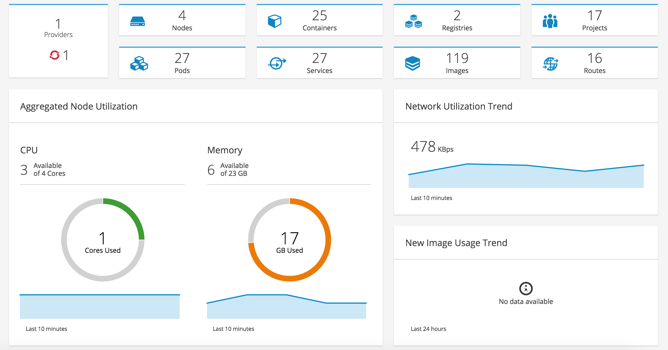

CLOUDFORMS 4.5 & CONTAINER MANAGEMENT
Ansible Automation, User Experience & Monitoring
Ansible Automation Inside
Default automation language for Red Hat CloudForms
User Experience
Dashboard update, new widgets
Topology enhancement
Predefined Container Roles, Reports
External Logging Integration
Monitoring
Ad hoc Metrics
Performance Reports
From Hawkular

Slide 54

Windows Containers on OpenShift (Preview)
Upstream project to improve Windows Containers and Kubernetes support
Collaboration between Microsoft, Red Hat and Kubernetes (Windows SIG)
Demo of OpenShift running mixed cluster with Windows Containers/Windows Server 2016 Nodes running with Linux Containers/RHEL Nodes
Running in OpenShift (kube pod) running .NET 4.5. With a java container as well.
Watch the demo video.

Slide 55
Partner Solutions
41 OpenShift Sponsor Partners at Summit
17 Primed Partners at Summit
35+ meetings with partners @ Summit
Press Releases - 5 Partner-led; 1 Red Hat-led
AWS, BlackDuck, EnterpriseDB, BigSwitch, JFrog and Avi Networks
Container Health Index Release
18 Partner Quotes/Mentions supporting release

Slide 56
















WHO IS DOING THIS?
read more at openshift.com/customers
Notes:
OpenShift has more than 200 customers worldwide across a broad set of industries. Here are a few example of who is implementing DevOps with containers on OpenShift.

Slide 57


KEYBANK
Thursday, May 4
Day 3 keynote (afternoon)
JOHN RZESZOTARSKI
Director of DevOps
As with many large companies, KeyBank found that application delivery resulted in complexity growth over time, with slow manual testing, quarterly release cycles and outages resulting in poor Mean-to-time-Resolution (MTTR). KeyBank recently went cloud-native and built a DevOps practice while using Red Hat OpenShift Container Platform. KeyBank's DevOps team wanted to embrace an approach that also provided greater security for customer information.

Slide 58

KEYBANK - Going Cloud-Native
“On Day 1 of our acquisition of a new bank, 10 changes were put into production, with 0 defects, during the middle of the day. That is the power of OpenShift.” -- John Rzeszotarski, Dir. DevOps, Keybank
One of Top 15 banks in the US
Acquiring banks to reshape their market.
Challenging regulatory environment made changes difficult.
Using OpenShift to heavily focus on Containers, Automated Testing and Continuous Delivery.
Migrating monolithic applications to Microservices.
OpenShift is driving their DevOps journey. Better collaboration between Devs and Ops.
Our “containergeddon” is now orchestrated on OpenShift
View the KeyBank keynote, read the KeyBank blog and press release
Notes:
KeyBank - Banking on OpenShift - a DevOps journey
https://www.youtube.com/watch?v=atKbJ1WJcvE
https://developers.redhat.com/blog/2016/10/27/the-fast-moving-monolith-how-we-sped-up-delivery-from-every-three-months-to-every-week/
https://www.redhat.com/en/about/press-releases/keybank-goes-cloud-native-builds-devops-practice-and-chooses-red-hat-openshift-container-platform
- Top 15 banks in the US
- Have acquired many banks over 190 years in existence
The Problem:
- Fast growing bank, working on legacy systems in silos
- Complex regulatory environment that make changes difficult
Their DevOps Journey: (via Farley’s Laws - Don’t Rework the Wheel)
- People Believe before they doubt
- Things are more complicated than you think
- Expect to make mistakes; learn to fail (and re-learn) fast
Selling DevOps within Your Enterprise:
- Have a Metrics Driven Approach
- Three areas of focus: Containers, Automated Testing, Continuous Delivery
- Need: Change Agents, Angel Funding (Internal), proper Project Selection >> something impactful
Online Banking Application >> Driven by a Team that supports DevOps-as-a-Service
- smoothly collaborate between Dev and Ops
- use containers to build images once, deploy anywhere
- heavy focus on automated testing
“Containergeddon” >> Now Orchestrated (with OpenShift/Kubernetes)
- On Day 1 of their acquisition of a new bank - 10 changes put into production, with 0 defects, during the middle of the day - that was the power of OpenShift.

Slide 59

“On Day 1 of our acquisition of a new bank - 10 changes were put into production, with 0 defects, during the middle of the day - that is the power of OpenShift.”
KEY BANK - Going Cloud-Native
Notes:
KeyBank - Banking on OpenShift - a DevOps journey
https://www.youtube.com/watch?v=atKbJ1WJcvE
https://developers.redhat.com/blog/2016/10/27/the-fast-moving-monolith-how-we-sped-up-delivery-from-every-three-months-to-every-week/
https://www.redhat.com/en/about/press-releases/keybank-goes-cloud-native-builds-devops-practice-and-chooses-red-hat-openshift-container-platform
- Top 15 banks in the US
- Have acquired many banks over 190 years in existence
The Problem:
- Fast growing bank, working on legacy systems in silos
- Complex regulatory environment that make changes difficult
Their DevOps Journey: (via Farley’s Laws - Don’t Rework the Wheel)
- People Believe before they doubt
- Things are more complicated than you think
- Expect to make mistakes; learn to fail (and re-learn) fast
Selling DevOps within Your Enterprise:
- Have a Metrics Driven Approach
- Three areas of focus: Containers, Automated Testing, Continuous Delivery
- Need: Change Agents, Angel Funding (Internal), proper Project Selection >> something impactful
Online Banking Application >> Driven by a Team that supports DevOps-as-a-Service
- smoothly collaborate between Dev and Ops
- use containers to build images once, deploy anywhere
- heavy focus on automated testing
“Containergeddon” >> Now Orchestrated (with OpenShift/Kubernetes)
- On Day 1 of their acquisition of a new bank - 10 changes put into production, with 0 defects, during the middle of the day - that was the power of OpenShift.

Slide 60


OPTUM - Digital Transformation Journey
“Speed to Value” is one of our new business metrics. We’re now delivering application updates monthly or weekly. It’s about changing the operating model.” -- John Hodgson, Sr. Dir, Optum
Technology arm of UnitedHealthcare Group (Fortune #6)
250k employees, 10k developers
Redefining how software is used for healthcare
Over 4000 applications on OpenShift
20+ Mission Critical applications on OpenShift, including all links to 3rd-party health providers
Deploying new SaaS applications to over 19k desktops
Moving from private data centers to Hybrid Cloud
Building “Cloud Scaffolding” (push-button-infrastructure) for developers, in partnership with Red Hat Open Innovation Labs
Technology Development Program hired 17 developers in 2009, which grew to 1600 developers in 2016.
View the Optum keynote & view theCube interview
Notes:
Optum - Digital Transformation Journey
https://www.youtube.com/watch?v=PtTnnw3DakY&feature=youtu.be&t=42m16s
https://www.youtube.com/watch?v=ipvBWdZ0OpA (theCUBE)
- Technology part of United Health Group (# on Fortune 500)
- Optum would be Fortune #31 (if standalone company)
- 250,000 employees, +10,000 developers.
- OptumCloud Platform
- Planning to move to a hybrid cloud using both AWS and Azure.
- “The OpenShift & AWS integration is a game-changer for us, thinking about our hybrid cloud needs. It’ll allow us to natively take advantage of public cloud services.”
Deployment Environment:
- OpenShift platform has been 100% stable for the last 6 months
- Over 4000 applications running on OpenShift
- 20 Mission Critical applications on OpenShift (Health4Me, all links to providers)
- Deploying new applications to 19,000 desktops via OpenShift (creating SaaS services for end-users)
Critical Challenges:
- Must change the mindset of their developers
- Must be able to integrate Apps and dynamic infrastructure
Driving Change:
“DevDays” - annual internal event (2 days) to learn new technologies
“Optum Developer” - portal to enable developers to consume, build and deploy digital assets for reuse across the enterprise.
“Technology Development Program (TDP)” - grown from 17 developers in 2009 to hiring 1600 new developers in 2016. Mentoring and peer-learning for developers, early career development. Open spaces, agile workspaces, lots of whiteboards. Startup mindset.
“Cloud Scaffolding” - using Red Hat “push-button-infrastructure (from Open Innovation Labs), running on OpenShift. Builds pre-defined templates for developer environments. Provides an integrated DevOps toolchain >> Goal is rapid developer processes.
Open Innovation Labs is helping to build the bridge between infrastructure and development.
“Speed to Value” is one of our new business metrics. We’re now delivering application updates monthly or weekly. It’s about changing the operating model.

Slide 61

OPTUM - Digital Transformation Journey
“Speed to Value” is one of our new business metrics. We’re now delivering application updates monthly or weekly. It’s about changing the operating model.”
Notes:
Optum - Digital Transformation Journey
https://www.youtube.com/watch?v=PtTnnw3DakY&feature=youtu.be&t=42m16s
https://www.youtube.com/watch?v=ipvBWdZ0OpA (theCUBE)
- Technology part of United Health Group (# on Fortune 500)
- Optum would be Fortune #31 (if standalone company)
- 250,000 employees, +10,000 developers.
- OptumCloud Platform
- Planning to move to a hybrid cloud using both AWS and Azure.
- “The OpenShift & AWS integration is a game-changer for us, thinking about our hybrid cloud needs. It’ll allow us to natively take advantage of public cloud services.”
Deployment Environment:
- OpenShift platform has been 100% stable for the last 6 months
- Over 4000 applications running on OpenShift
- 20 Mission Critical applications on OpenShift (Health4Me, all links to providers)
- Deploying new applications to 19,000 desktops via OpenShift (creating SaaS services for end-users)
Critical Challenges:
- Must change the mindset of their developers
- Must be able to integrate Apps and dynamic infrastructure
Driving Change:
“DevDays” - annual internal event (2 days) to learn new technologies
“Optum Developer” - portal to enable developers to consume, build and deploy digital assets for reuse across the enterprise.
“Technology Development Program (TDP)” - grown from 17 developers in 2009 to hiring 1600 new developers in 2016. Mentoring and peer-learning for developers, early career development. Open spaces, agile workspaces, lots of whiteboards. Startup mindset.
“Cloud Scaffolding” - using Red Hat “push-button-infrastructure (from Open Innovation Labs), running on OpenShift. Builds pre-defined templates for developer environments. Provides an integrated DevOps toolchain >> Goal is rapid developer processes.
Open Innovation Labs is helping to build the bridge between infrastructure and development.
“Speed to Value” is one of our new business metrics. We’re now delivering application updates monthly or weekly. It’s about changing the operating model.

Slide 62














2017 Red Hat Summit Breakout Sessions

Slide 63

About OpenShift Commons
Community of OpenShift customers, partners and users to connect, share best practices and collaborate on upstream projects
270+ member organizations in over 70 countries and rapidly growing
Gatherings typically scheduled around KubeCon & Red Hat Summit
At Red Hat Summit: 360+ attendees from 140 member orgs
Customer presentations from: Macquarie Bank, ATPCO, Point 72 Asset Mgmt, Swiss Federal Railways, Inmarsat, and more
Learn more and become a member: commons.openshift.org

Slide 64








OpenShift Commons Presentations
Video | Slides
Video | Slides
Video | Slides
Video | Slides
Video | Slides
Video | Slides
Video | Slides
Video | Slides
Video | Slides
Detailed OpenShift Commons recap including videos, slides and ask-the-experts sessions

Slide 65
OPENSHIFT MOMENTUM

Slide 66

Containers in production are real. And they are
real on OpenShift.
Blog: The Breadth and Reach of the OpenShift Marketplace
Notes:
https://blog.openshift.com/the-breadth-and-reach-of-the-openshift-marketplace/

Slide 67




OUR HYBRID CLOUD PORTFOLIO
FY2017 subscription revenue and y/y growth
EMERGING/CLOUD-ENABLING
>$100M | +100%
GROWTH
~$300M | 20%-25%
ESTABLISHED
~$1,700M | 10%-15%
Cloud management
NFV
Openshift (PaaS)
OpenStack (IaaS)
Storage
Application development
Infrastructure
Chart for illustration purposes only. Not to be construed as guidance.
Notes:
Please see Red Hat Analyst detail presentation for more details: https://investors.redhat.com/news-and-events/events-and-presentations

Slide 68



CUSTOMER ADOPTION OF TOP EMERGING TECHNOLOGIES
(acquired FY16)
400
500
600
300
375
450
CUSTOMERS
200
250
300
100
125
150
0
0
0
FY15
FY16
FY17
FY15
FY16
FY17
FY16
FY17
Source: company customer subscription data
Notes:
* Salesforce Data, using global customer name where end customer information is available, subs only, revenue proxy
** Count of customers with product revenue in the fiscal year
Please see Red Hat Analyst detail presentation for more details: https://investors.redhat.com/news-and-events/events-and-presentations

Slide 69




TOP EMERGING TECHNOLOGY ADOPTION BY VERTICAL
17%
30%
15%
34%
25%
26%
37%
34%
23%
Financial services
Government
Telco
Media/technology
Other
*Verticals distribution based on FY17 annualized subscription data
Notes:
Please see Red Hat Analyst detail presentation for more details: https://investors.redhat.com/news-and-events/events-and-presentations

Slide 70

Analyst views of Red Hat Summit 2017
Red Hat 2017: Turning point for Red Hat Positioning
“Red Hat Summit always provides insight into where the company is heading, and Red Hat Summit 2017 was no exception. OpenShift.io addresses a hole in the company's portfolio.
The AWS partnership combines Red Hat's open source heritage with AWS's rapid innovation of public cloud services on comprehensive infrastructure.
Red Hat is making big plans to stay in sync with the industry moving forward.” -- IDC, May 2017

Slide 71
Top Blog Posts
What makes us Red Hat -- Paul Cormier
Containers are Linux -- Joe Fernandes
The Breadth and Reach of the OpenShift Marketplace -- Brian Gracely
AWS and Red Hat -- Digging a little deeper -- Chris Morgan

Slide 72





RED HAT OPEN INNOVATION LABS
INNOVATION
ACCELERATED
MODERNIZE TRADITIONAL APPS
• Extend applications
• Optimize applications
• Scale applications
• Expose to orchestration
DEVELOP CONTEMPORARY APPS
• Develop on PaaS environment
• Transform how you design and develop apps
• Adopt lean and agile principles
• Master DevOps practices
COLLABORATION
Space to work, innovate, and discuss
RESIDENCY
An eight-week accelerated teaming engagement
COMMUNITY INCUBATION
Communities supporting innovation
Notes:
Red Hat Open Innovation Labs is a focused and intimate teaming engagement that helps companies accelerate innovation—by providing the people, processes, and technologies required to meet modern business challenges.
It is a platform to help customers bring their innovative ideas to market—more quickly. Customers learn how to build and containerize applications on OpenShift, while working closely with Red Hat subject matter experts to understand and integrate DevOps approaches and methodologies to be able to accelerate innovation now and into the future.
At the close of a Red Hat Open Innovation Labs engagement, you leave with the skills, and the community-powered tools and methodologies, to drive and sustain innovation.

Slide 73
THANK YOU
plus.google.com/+RedHat
facebook.com/redhatinc
linkedin.com/company/red-hat
twitter.com/RedHatNews
youtube.com/user/RedHatVideos

